Slide 1
Chapter 6: Synchronization Tools

Slide 2
Outline
Background
The Critical-Section Problem
Peterson’s Solution
Hardware Support for Synchronization
Mutex Locks
Semaphores
Monitors
Liveness
Evaluation

Slide 3
Objectives
Describe the critical-section problem and illustrate a race condition
Illustrate hardware solutions to the critical-section problem using memory barriers, compare-and-swap operations, and atomic variables
Demonstrate how mutex locks, semaphores, monitors, and condition variables can be used to solve the critical section problem
Evaluate tools that solve the critical-section problem in low-, Moderate-, and high-contention scenarios

Slide 4
Background
Processes can execute concurrently
May be interrupted at any time, partially completing execution
Concurrent access to shared data may result in data inconsistency
Maintaining data consistency requires mechanisms to ensure the orderly execution of cooperating processes
We illustrated in chapter 4 the problem when we considered the Bounded Buffer problem with use of a counter that is updated concurrently by the producer and consumer,. Which lead to race condition.

Slide 5
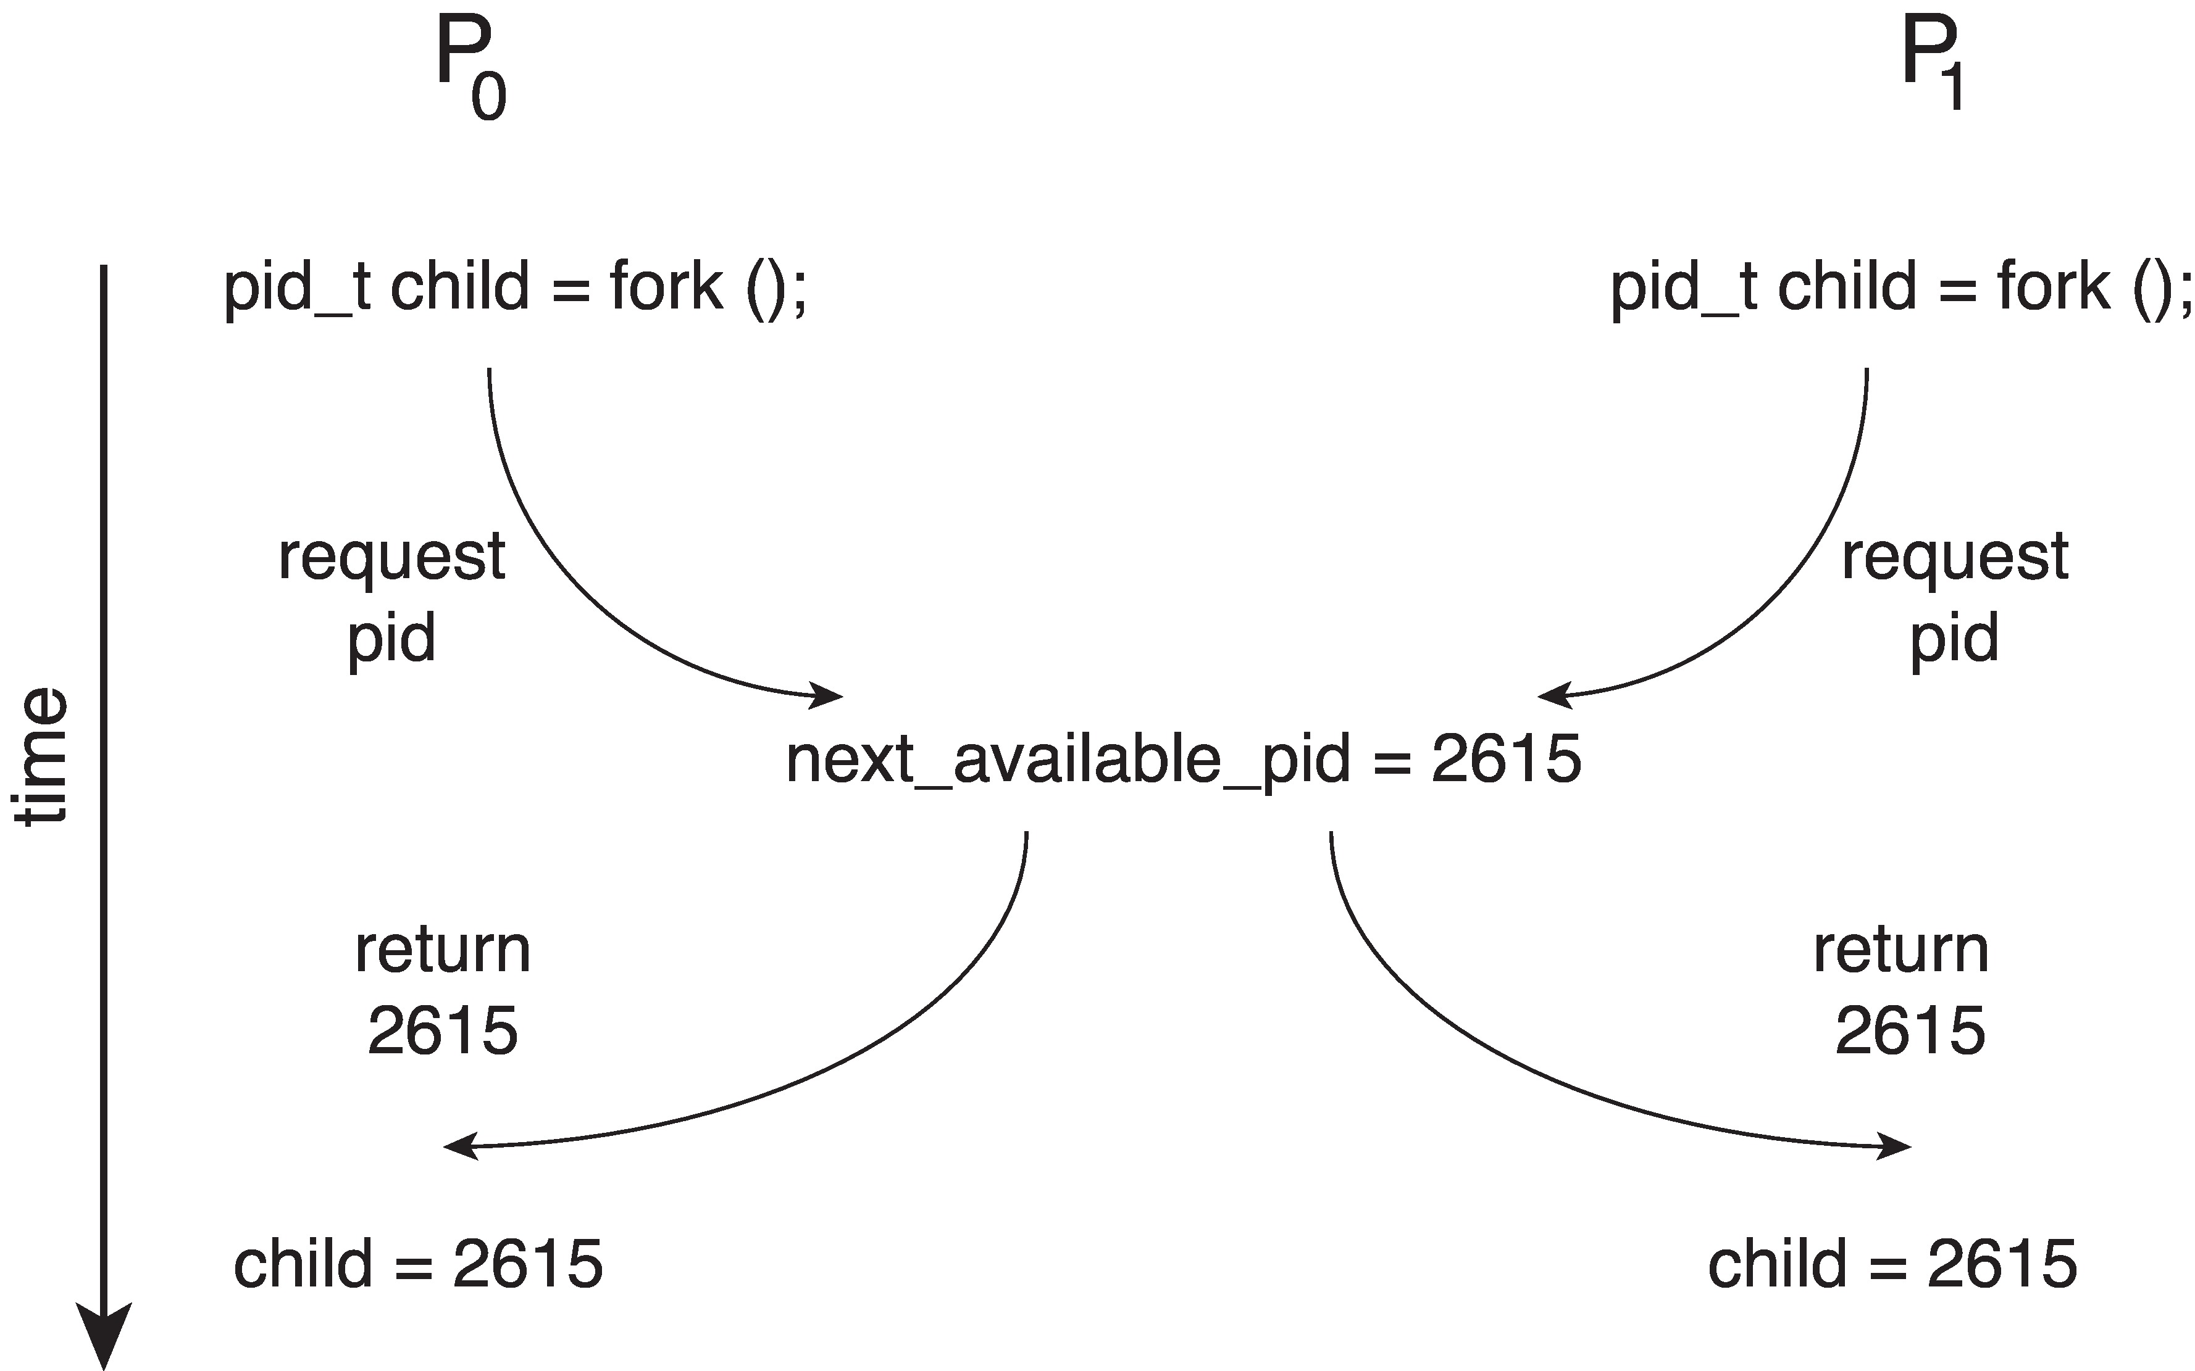
Race Condition
Processes P₀ and P₁ are creating child processes using the fork() system call
Race condition on kernel variable next_available_pid which represents the next available process identifier (pid)
Unless there is a mechanism to prevent P₀ and P₁ from accessing the variable next_available_pid the same pid could be assigned to two different processes!

Slide 6
Critical Section Problem
Consider system of n processes {p₀, p₁, … p_{n-1}}
Each process has critical section segment of code
Process may be changing common variables, updating table, writing file, etc.
When one process in critical section, no other may be in its critical section
Critical section problem is to design protocol to solve this
Each process must ask permission to enter critical section in entry section, may follow critical section with exit section, then remainder section

Slide 7
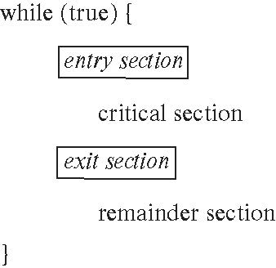
Critical Section
General structure of process P_{i}

Slide 8
Critical-Section Problem (Cont.)
Requirements for solution to critical-section problem
Mutual Exclusion - If process P_{i} is executing in its critical section, then no other processes can be executing in their critical sections
Progress - If no process is executing in its critical section and there exist some processes that wish to enter their critical section, then the selection of the process that will enter the critical section next cannot be postponed indefinitely
Bounded Waiting - A bound must exist on the number of times that other processes are allowed to enter their critical sections after a process has made a request to enter its critical section and before that request is granted
Assume that each process executes at a nonzero speed
No assumption concerning relative speed of the n processes

Slide 9
Interrupt-based Solution
Entry section: disable interrupts
Exit section: enable interrupts
Will this solve the problem?
What if the critical section is code that runs for an hour?
Can some processes starve – never enter their critical section.
What if there are two CPUs?

Slide 10
Software Solution 1
Two process solution
Assume that the load and store machine-language instructions are atomic; that is, cannot be interrupted
The two processes share one variable:
int turn;
The variable turn indicates whose turn it is to enter the critical section
initially, the value of turn is set to i

Slide 11
Algorithm for Process P_{i}
while (true){
while (turn = = j);
/* critical section */
turn = j;
/* remainder section */
}

Slide 12
Correctness of the Software Solution
Mutual exclusion is preserved
P_{i} enters critical section only if:
turn = i
and turn cannot be both 0 and 1 at the same time
What about the Progress requirement?
What about the Bounded-waiting requirement?

Slide 13
Peterson’s Solution
Two process solution
Assume that the load and store machine-language instructions are atomic; that is, cannot be interrupted
The two processes share two variables:
int turn;
boolean flag[2]
The variable turn indicates whose turn it is to enter the critical section
The flag array is used to indicate if a process is ready to enter the critical section.
flag[i] = true implies that process P_{i} is ready!

Slide 14
Algorithm for Process P_{i}
while (true){
flag[i] = true;
turn = j;
while (flag[j] && turn = = j)
;
/* critical section */
flag[i] = false;
/* remainder section */
}

Slide 15
Correctness of Peterson’s Solution
Provable that the three CS requirement are met:
1. Mutual exclusion is preserved
P_{i} enters CS only if:
either flag[j] = false or turn = i
2. Progress requirement is satisfied
3. Bounded-waiting requirement is met

Slide 16
Peterson’s Solution and Modern Architecture
Although useful for demonstrating an algorithm, Peterson’s Solution is not guaranteed to work on modern architectures.
To improve performance, processors and/or compilers may reorder operations that have no dependencies
Understanding why it will not work is useful for better understanding race conditions.
For single-threaded this is ok as the result will always be the same.
For multithreaded the reordering may produce inconsistent or unexpected results!

Slide 17
Modern Architecture Example
Two threads share the data: boolean flag = false; int x = 0;
Thread 1 performs while (!flag) ; print x
Thread 2 performs x = 100; flag = true
What is the expected output?
100

Slide 18
Modern Architecture Example (Cont.)
However, since the variables flag and x are independent of each other, the instructions:
flag = true; x = 100;
for Thread 2 may be reordered
If this occurs, the output may be 0!

Slide 19
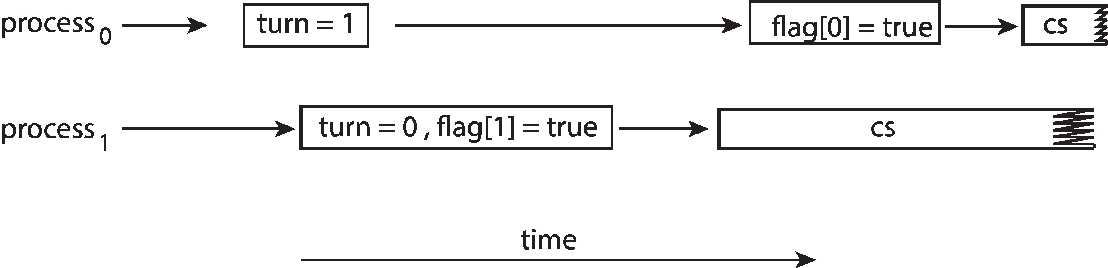
Peterson’s Solution Revisited
The effects of instruction reordering in Peterson’s Solution
This allows both processes to be in their critical section at the same time!
To ensure that Peterson’s solution will work correctly on modern computer architecture we must use Memory Barrier.

Slide 20
Memory Barrier
Memory model are the memory guarantees a computer architecture makes to application programs.
Memory models may be either:
Strongly ordered – where a memory modification of one processor is immediately visible to all other processors.
Weakly ordered – where a memory modification of one processor may not be immediately visible to all other processors.
A memory barrier is an instruction that forces any change in memory to be propagated (made visible) to all other processors.

Slide 21
Memory Barrier Instructions
When a memory barrier instruction is performed, the system ensures that all loads and stores are completed before any subsequent load or store operations are performed.
Therefore, even if instructions were reordered, the memory barrier ensures that the store operations are completed in memory and visible to other processors before future load or store operations are performed.

Slide 22
Memory Barrier Example
Returning to the example of slides 6.17 - 6.18
We could add a memory barrier to the following instructions to ensure Thread 1 outputs 100:
Thread 1 now performs while (!flag) memory_barrier(); print x
Thread 2 now performs x = 100; memory_barrier(); flag = true
For Thread 1 we are guaranteed that that the value of flag is loaded before the value of x.
For Thread 2 we ensure that the assignment to x occurs before the assignment flag.
Note that memory barriers are considered very low-level operations and are typically only used by kernel developers when writing specialized code that ensures mutual exclusion

Slide 23
Synchronization Hardware
Many systems provide hardware support for implementing the critical section code.
Uniprocessors – could disable interrupts
Currently running code would execute without preemption
Generally too inefficient on multiprocessor systems
Operating systems using this not broadly scalable
We will look at three forms of hardware support: 1. Hardware instructions 2. Atomic variables

Slide 24
Hardware Instructions
Special hardware instructions that allow us to either test-and-modify the content of a word, or to swap the contents of two words atomically (uninterruptedly.)
Test-and-Set instruction
Compare-and-Swap instruction

Slide 25
The test_and_set Instruction
Definition
boolean test_and_set (boolean *target)
{
boolean rv = *target;
*target = true;
return rv:
}
Properties
Executed atomically
Returns the original value of passed parameter
Set the new value of passed parameter to true

Slide 26
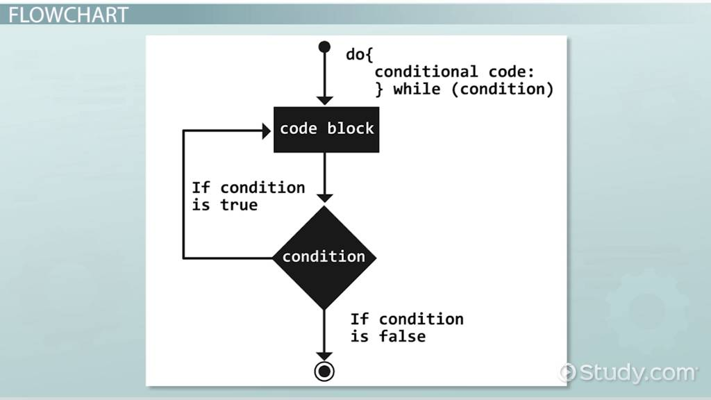
Solution Using test_and_set()
Shared boolean variable lock, initialized to false
Solution:
do { Lock=True waiting while (test_and_set(&lock))
; /* do nothing */
/* critical section */
lock = false;
/* remainder section */
} while (true);
test and set repeatedly executed as while loop
If rv is false some time next process will get chance; lock and target pointing same. So once again true for target and all other process in waiting
NO I and j so no bounded wait…..

Slide 27
The shared variable is lock which is initialized to false.
TestAndSet(lock) algorithm works in this way –
It always returns whatever value is sent to it and sets lock to true. The first process will enter the critical section at once as TestAndSet(lock) will return false and it’ll break out of the while loop. The other processes cannot enter now as lock is set to true and so the while loop continues to be true. Mutual exclusion is ensured.
Once the first process gets out of the critical section, lock is changed to false. So, now the other processes can enter one by one. Progress is also ensured.
However, after the first process, any process can go in. There is no queue maintained, so any new process that finds the lock to be false again can enter. So bounded waiting is not ensured.

Slide 28
The compare_and_swap Instruction
Definition
int compare_and_swap(int *value, int expected, int new_value)
{
int temp = *value;
if (*value == expected)
*value = new_value; value always “1”
return temp;
}
Properties
Executed atomically
Returns the original value of passed parameter value
Set the variable value the value of the passed parameter new_value but only if *value == expected is true. That is, the swap takes place only under this condition.
The operand value is set to new value only if the expression (*value
== expected) is true.

Slide 29
Solution using compare_and_swap
Shared integer lock initialized to 0;
Solution:
while (true){ (1!=0) Wait while (compare_and_swap(&lock, 0, 1) != 0)
; /* do nothing */
/* critical section */
lock = 0;
/* remainder section */
}
Does it solve the critical-section problem?

Slide 31
Basically, compare and swap compares an expected value to the concrete value of a variable, and if the concrete value of the variable is equals to the expected value, swaps the value of the variable for a new variable.
Mutual exclusion using CAS can be provided as follows:
A global variable (lock) is declared and is initialized to 0. The first process that invokes compare and swap() will set lock to 1. It will then enter its critical section, because the original value of lock was equal to the expected value of 0.
Although this algorithm satisfies the mutual-exclusion requirement, it does not satisfy the bounded-waiting requirement hence next algorithm….

Slide 32
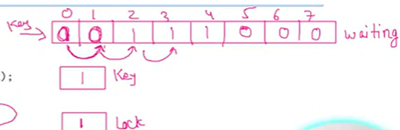
Bounded-waiting with compare-and-swap
while (true) { waiting[i] = true; it is queue for all waiting process want to go in CS section key = 1; while (waiting[i] && key == 1) both true means ready
key = compare_and_swap(&lock,0,1);
waiting[i] = false;
/* critical section */
j = (i + 1) % n; circular queue
while ((j != i) && !waiting[j])
j = (j + 1) % n;
if (j == i)
lock = 0;
else
waiting[j] = false;
/* remainder section */
}
The above algorithm satisfies all
the critical-section requirements.

Slide 33
To prove that the mutual-exclusion requirement is met, we note that process Pi can enter its critical section only if either waiting[i] == false or key == 0. The value of key can become 0 only if the compare and swap() is executed. The first process to execute the compare and swap() will find key == 0; all others must wait. The variable waiting[i] can become false only if another process leaves its critical section; only one waiting[i] is set to false, maintaining the mutual-exclusion requirement.
To prove that the progress requirement is met, we note that the arguments presented for mutual exclusion also apply here, since a process exiting the critical section either sets lock to 0 or sets waiting[j] to false. Both allow a process that is waiting to enter its critical section to proceed.
To prove that the bounded-waiting requirement is met, we note that, when a process leaves its critical section, it scans the array waiting in the cyclic ordering (i + 1, i + 2, ..., n − 1, 0, ..., i − 1). It designates the first process in this ordering that is in the entry section (waiting[j] == true) as the next one to enter the critical section

Slide 34
Atomic Variables
Typically, instructions such as compare-and-swap are used as building blocks for other synchronization tools.
One tool is an atomic variable that provides atomic (uninterruptible) updates on basic data types such as integers and booleans.
For example:
Let sequence be an atomic variable
Let increment() be operation on the atomic variable sequence
The Command:
increment(&sequence);
ensures sequence is incremented without interruption:

Slide 35
Atomic Variables
The increment() function can be implemented as follows: void increment(atomic_int *v) { int temp; do { temp = *v; } while (temp != (compare_and_swap(v,temp,temp+1)); } Atomic variables can be used in to ensure mutual exclusion in situations where there may be a data race on a single variable while it is being updated, as when a counter is incremented.

Slide 37
Mutex Locks
Previous solutions are complicated and generally inaccessible to application programmers
OS designers build software tools to solve critical section problem
Simplest is mutex lock
Boolean variable indicating if lock is available or not
Protect a critical section by
First acquire() a lock
Then release() the lock
Calls to acquire() and release() must be atomic
Usually implemented via hardware atomic instructions such as compare-and-swap.
But this solution requires busy waiting
This lock therefore called a spinlock

Slide 38
Solution to CS Problem Using Mutex Locks
while (true) {
acquire lock
critical section
release lock
remainder section
}

Slide 39
Semaphore
Synchronization tool that provides more sophisticated ways (than Mutex locks) for processes to synchronize their activities.
Semaphore S – integer variable
s=+ve no. of process/resources s=-ve no. of process waiting
Can only be accessed via two idivisible (atomic) operations
wait() and signal()
Originally called P() and V()
Definition of the wait() operation
wait(S) {
while (S <= 0)
; // busy wait
S--;
}
Definition of the signal() operation
signal(S) {
S++;
}

Slide 40
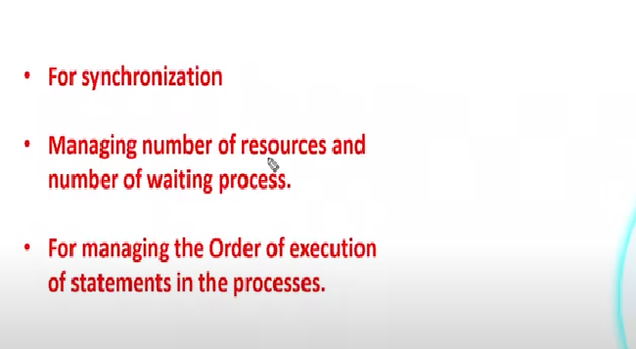
Use of Semaphore

Slide 41
Semaphore (Cont.)
Counting semaphore – integer value can range over an unrestricted domain
Binary semaphore – integer value can range only between 0 and 1
Same as a mutex lock
Can implement a counting semaphore S as a binary semaphore
With semaphores we can solve various synchronization problems

Slide 42
Semaphore Usage Example
Solution to the CS Problem
Create a semaphore “mutex” initialized to 1
wait(mutex);
CS
signal(mutex);
Consider P₁ and P₂ that with two statements S₁ and S₂ and the requirement that S₁ to happen before S_{2------ order of execution}
Create a semaphore “synch” initialized to 0
P1:
S₁;
signal(synch);
P2:
wait(synch);
S₂;

Slide 43
Semaphore Implementation
Must guarantee that no two processes can execute the wait() and signal() on the same semaphore at the same time
Thus, the implementation becomes the critical section problem where the wait and signal code are placed in the critical section
Could now have busy waiting in critical section implementation
But implementation code is short
Little busy waiting if critical section rarely occupied
Note that applications may spend lots of time in critical sections and therefore this is not a good solution

Slide 44
Semaphore Implementation with no Busy waiting
With each semaphore there is an associated waiting queue
Each entry in a waiting queue has two data items:
Value (of type integer)
Pointer to next record in the list
PCB of each process are used in linked list
Two operations:
block – place the process invoking the operation on the appropriate waiting queue
wakeup – remove one of processes in the waiting queue and place it in the ready queue

Slide 45
Implementation with no Busy waiting (Cont.)
Waiting queue
typedef struct {
int value;
struct process *list; pcb point
} semaphore;
S1
Value
P1
Value
P2
Value
P3

Slide 46
Implementation with no Busy waiting (Cont.)
wait(semaphore *S) {
S->value--;
if (S->value < 0) { add this process to S->list; --adding all process in WQueue
block(); ---- making free for CPU for work process will go in waiting queue
}
}
signal(semaphore *S) {
S->value++;
if (S->value <= 0) { remove a process P from S->list;
wakeup(P); ---- remove process from waiting queue
}
}

Slide 47
Problems with Semaphores
Incorrect use of semaphore operations:
signal(mutex) …. wait(mutex)
wait(mutex) … wait(mutex)
Omitting of wait (mutex) and/or signal (mutex)
These – and others – are examples of what can occur when semaphores and other synchronization tools are used incorrectly.

Slide 49
Monitors
A high-level abstraction that provides a convenient and effective mechanism for process synchronization
Abstract data type, internal variables only accessible by code within the procedure
Only one process may be active within the monitor at a time
Pseudocode syntax of a monitor:
monitor monitor-name
{
// shared variable declarations
procedure P1 (…) { …. }
procedure P2 (…) { …. }
procedure Pn (…) {……}
initialization code (…) { … }
}

Slide 50
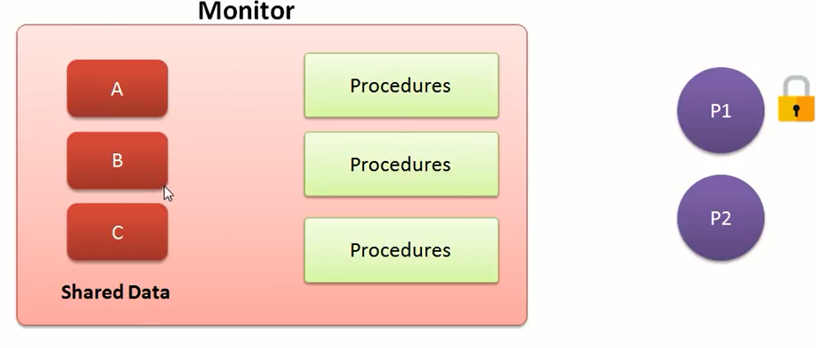
Monitor is a module:

Slide 51
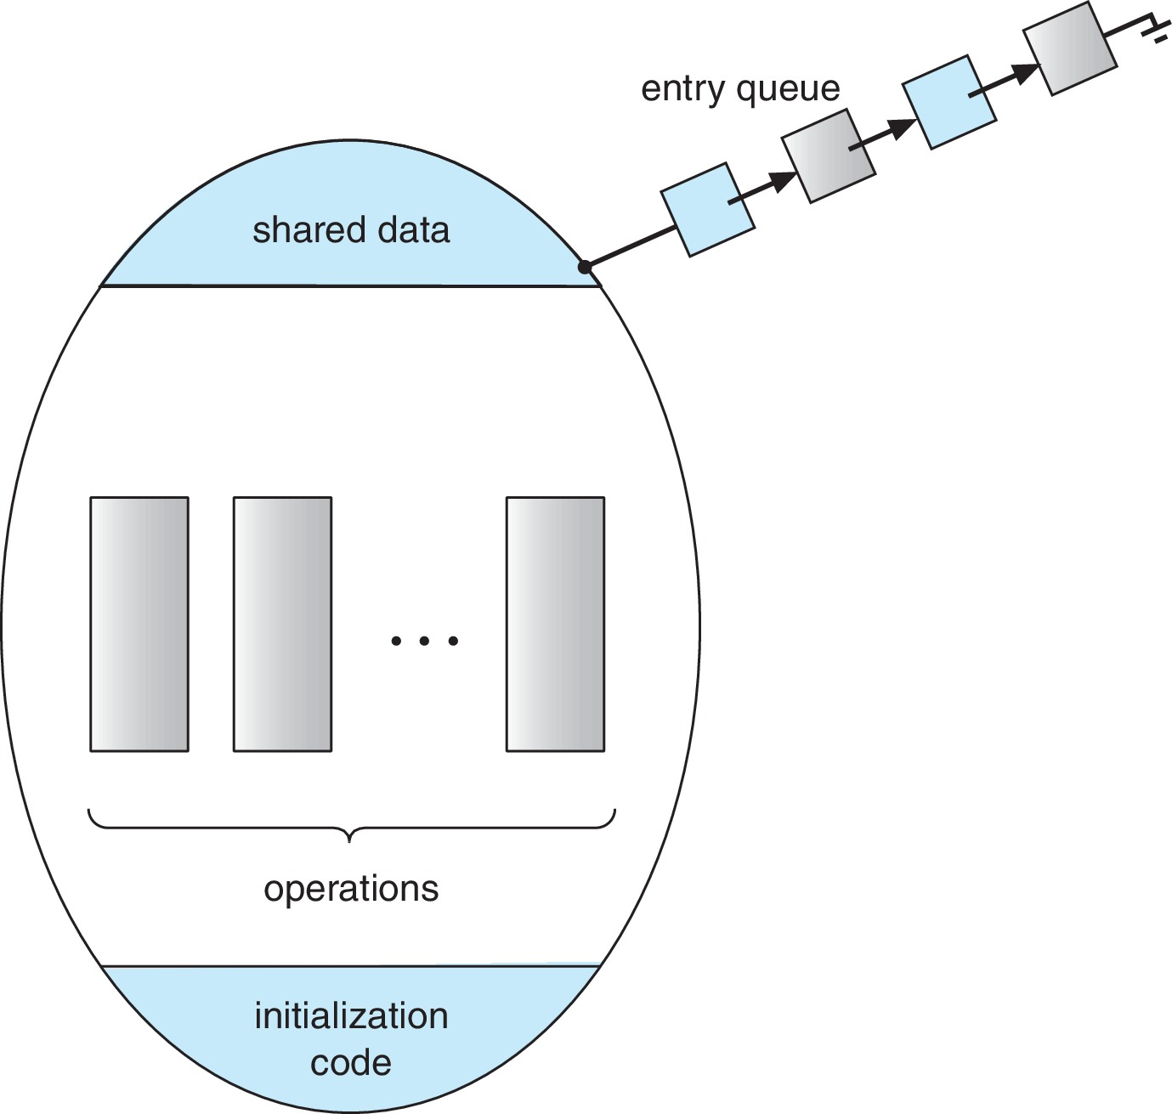
Schematic view of a Monitor

Slide 52
Monitor Implementation Using Semaphores
Variables
semaphore mutex
mutex = 1
Each procedure P is replaced by
wait(mutex);
…
body of P;
…
signal(mutex);
Mutual exclusion within a monitor is ensured

Slide 53
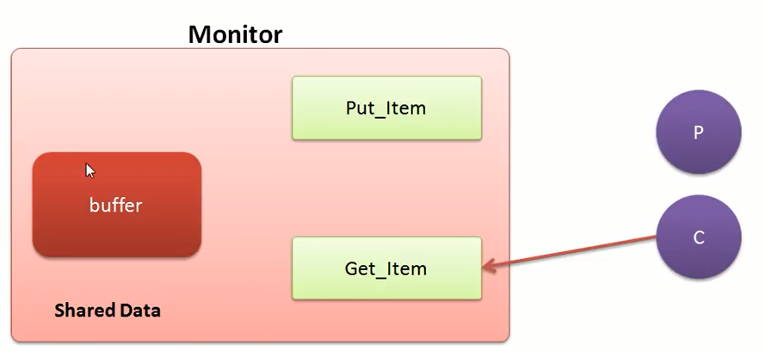

Slide 54
Condition Variables
condition x, y;
Two operations are allowed on a condition variable:
x.wait() – a process that invokes the operation is suspended until x.signal()
x.signal() – resumes one of processes (if any) that invoked x.wait()
If no x.wait() on the variable, then it has no effect on the variable

Slide 55
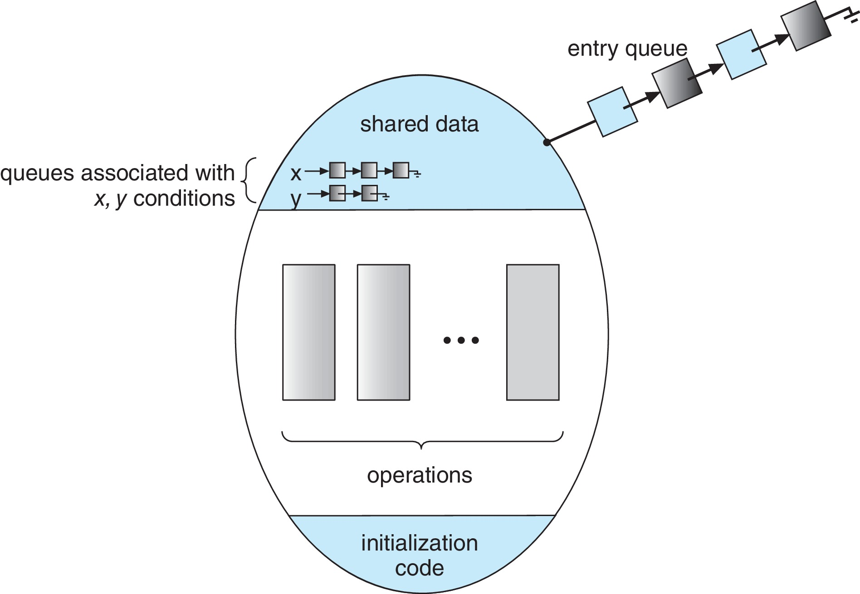
Monitor with Condition Variables

Slide 56
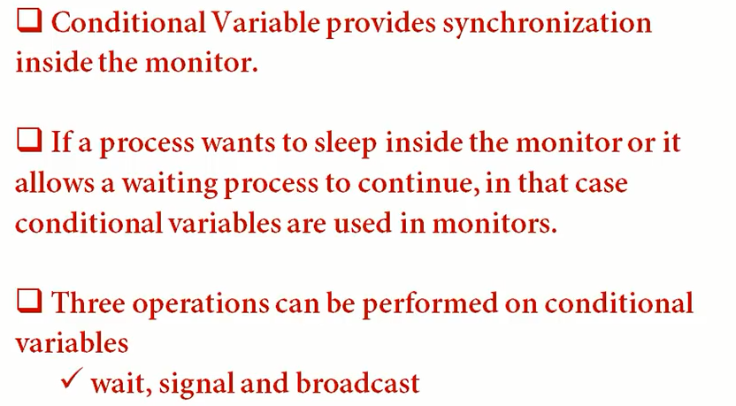
Conditional variable

Slide 57
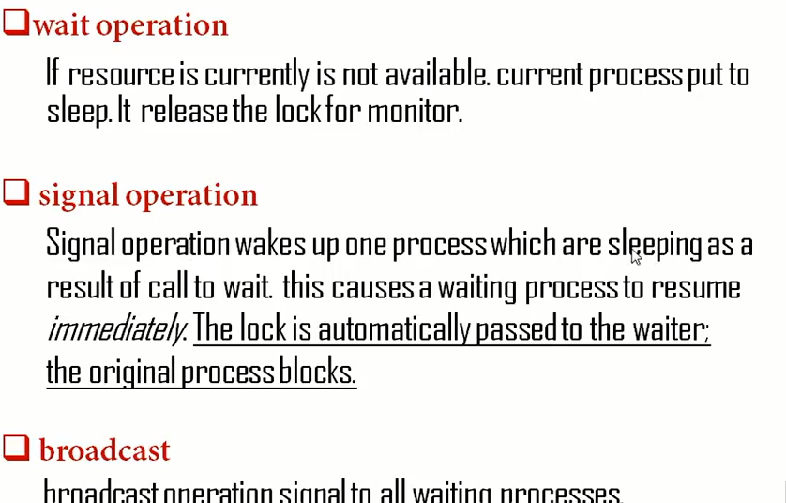

Slide 58
Usage of Condition Variable Example
Consider P₁ and P₂ that that need to execute two statements S₁ and S₂ and the requirement that S₁ to happen before S₂
Create a monitor with two procedures F₁ and F₂ that are invoked by P₁ and P₂ respectively
One condition variable “x” initialized to 0
One Boolean variable “done”
F1:
S₁;
done = true;
x.signal();
F2:
if done = false
x.wait()
S₂;

Slide 59
Monitor Implementation Using Semaphores
Variables
semaphore mutex; // (initially = 1)
semaphore next; // (initially = 0)
int next_count = 0; // number of processes waiting
inside the monitor
Each function P will be replaced by
wait(mutex);
…
body of P;
…
if (next_count > 0)
signal(next)
else
signal(mutex);
Mutual exclusion within a monitor is ensured

Slide 60
Implementation – Condition Variables
For each condition variable x, we have:
semaphore x_sem; // (initially = 0)
int x_count = 0;
The operation x.wait() can be implemented as:
x_count++;
if (next_count > 0)
signal(next);
else
signal(mutex);
wait(x_sem);
x_count--;

Slide 61
Implementation (Cont.)
The operation x.signal() can be implemented as:
if (x_count > 0) {
next_count++;
signal(x_sem);
wait(next);
next_count--;
}

Slide 62
Resuming Processes within a Monitor
If several processes queued on condition variable x, and x.signal() is executed, which process should be resumed?
FCFS frequently not adequate
Use the conditional-wait construct of the form
x.wait(c)
where:
c is an integer (called the priority number)
The process with lowest number (highest priority) is scheduled next

Slide 63
Single Resource allocation
Allocate a single resource among competing processes using priority numbers that specifies the maximum time a process plans to use the resource
R.acquire(t);
...
access the resurce;
...
R.release;
Where R is an instance of type ResourceAllocator

Slide 64
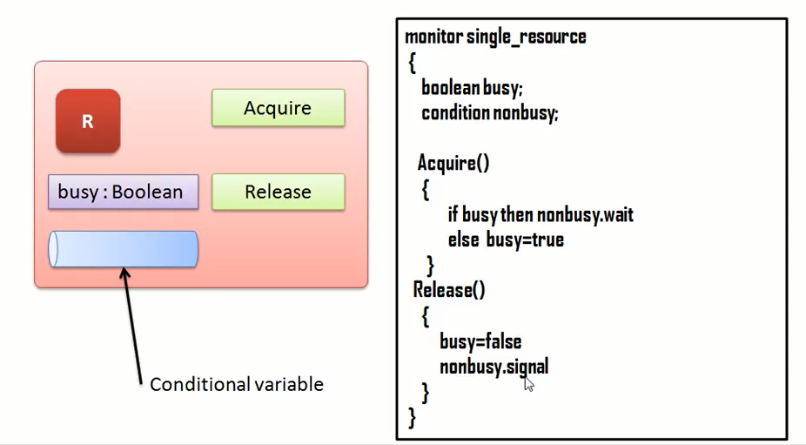

Slide 65
Single Resource allocation
Allocate a single resource among competing processes using priority numbers that specifies the maximum time a process plans to use the resource
The process with the shortest time is allocated the resource first
Let R is an instance of type ResourceAllocator (next slide)
Access to ResourceAllocator is done via:
R.acquire(t);
...
access the resurce;
...
R.release;
Where t is the maximum time a process plans to use the resource

Slide 66
A Monitor to Allocate Single Resource
monitor ResourceAllocator
{
boolean busy;
condition x;
void acquire(int time) {
if (busy)
x.wait(time);
busy = true;
}
void release() {
busy = false;
x.signal();
}
initialization code() {
busy = false;
}
}

Slide 67
Single Resource Monitor (Cont.)
Usage:
acquire
...
release
Incorrect use of monitor operations
release() … acquire()
acquire() … acquire())
Omitting of acquire() and/or release()

Slide 68
End of Chapter 6

